Slide 1
ARIMA Models for Linear Regression
Analyzing Three Years of Bitcoin Prices
By Ian MacKay

Slide 2
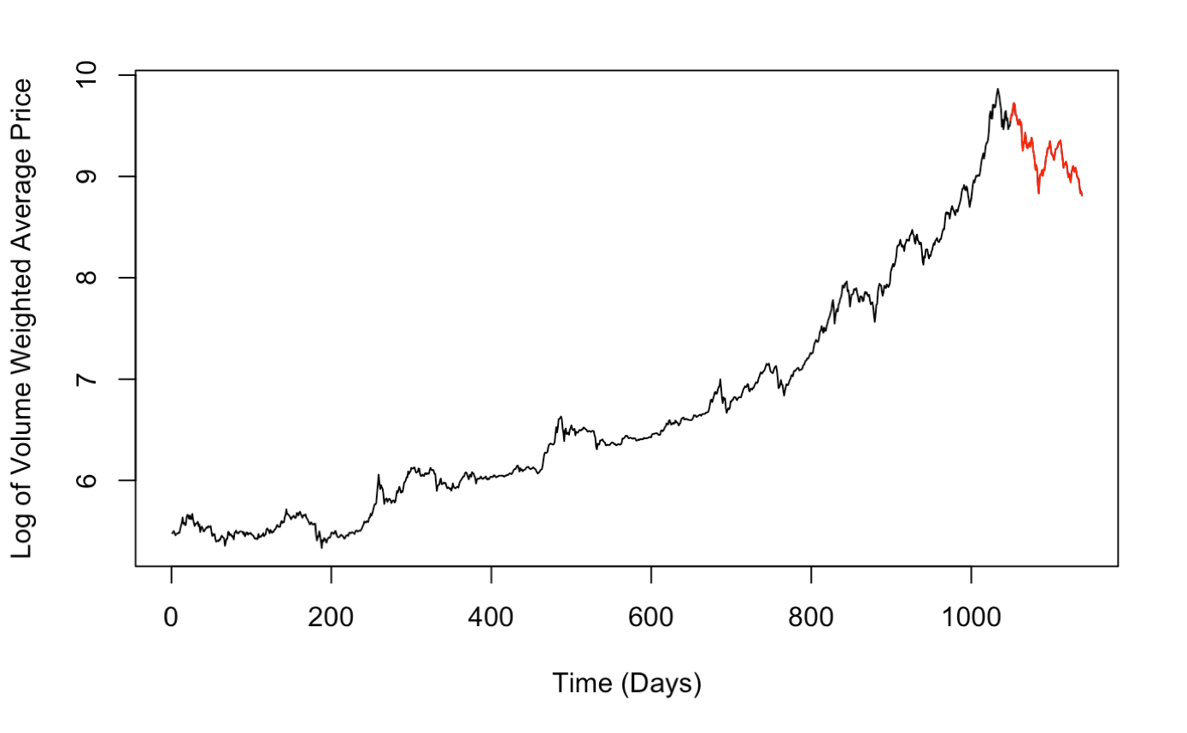
Bitcoin Prices: Train and Test Data
Using the logarithm of Volume Weighted Average Price
Train
Test

Slide 3
ARIMA Model Basics
Autoregressive Integrated Moving Average combines several concepts
AR: Autoregression
MA: Moving Average
Differencing
ARIMA works well on Time Series data: Sales, Inventory, Stock Prices
Univariate models only

Slide 4
Choosing an ARIMA Model
Periodicity and Seasonality must be accounted for, and the data must be stationary (Trends must be removed)
Nonseasonal ARIMA(p,d,q): p is order of AR model, d is order of differencing, and q is order of MA model
Seasonal ARIMA(p,d,q)(P,D,Q)m: m is seasonality, P, D, and Q are same as previous but for the specific season
AR and MA can be determined using Autocorrelation Function + Partial-ACF

Slide 5
Analysis of ACF Plot
Shape | Indicated Model
Exponential, decaying to zero | AR model. Use the PACF plot to help identify the order.
Alternating positive and negative, decaying to zero | AR model. Use the PACF plot to help identify the order.
One or more spikes, rest are essentially zero | MA model, order identified by where plot becomes zero.
Decay, starting after a few lags | Mixed autoregressive and moving average model.
All zero or close to zero | Data are essentially random.
High values at fixed intervals | Include seasonal autoregressive term.
No decay to zero | Series is not stationary.

Slide 6
Determinations for Bitcoin Data

Slide 7
Results of ARIMA
ARIMA(1,1,0)(1,0,0)₃₅
Actual
Predicted

Slide 8
Comparisons
ARIMA Model | AIC | BIC
(0,1,0)x(1,0,0)₃₅ | 14045.57 | 14055.48
(0,1,1)x(1,0,0)₃₅ | 14018.67 | 14033.53
(0,1,2)x(1,0,0)₃₅ | 14016.73 | 14036.54
(1,1,0)x(1,0,0)₃₅ | 14016.00 | 14030.86
(1,1,1)x(1,0,0)₃₅ | 14017.32 | 14037.14
(0,1,1)x(1,0,0)₁ | 14066.36 | 14081.22
(0,1,1)x(1,0,0)₇ | 13983.62 | 13998.48
(0,1,1)x(1,0,0)₁₄ | 14064.02 | 14078.88
(0,1,1)x(1,0,0)₂₁ | 14068.33 | 14083.19
(0,1,1)x(1,0,0)₄₉ | 14063.12 | 14077.98
(0,1,1)x(1,0,0)₉₀ | 14068.40 | 14083.27

Slide 9
Questions?

